Slide 1
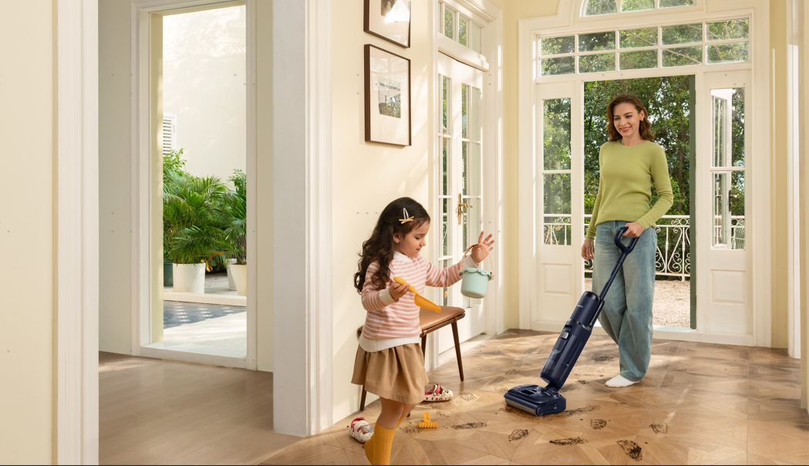








FLOOR ONE S7 Stretch Steam
Smart Cordless Steam Floor Washer
Specifications
General | Launch Date | 2025
 | Type | Smart Wet Dry Vacuum & Washer
 | Color | BLACK
 | Display | LED Display
Performance | Power Rating | 285W
 | Motor | Brushless Motor
 | Mode | Auto/Max/Steam/Suction
 | Max Suction power | 22kpa
 | Steam Temperature | 140℃（Boiler）
 | Clean Water Tank Capacity | 0.88L
 | Dirty Water Tank Capacity | 0.7L
 | Filter System | Dry Filter
 | SilentDry Noise | ≤45dB(A)
 | Self-clean | 85℃ FlashDry self-clean
140℃
HyperSteam
85℃ FlashDry Self-Cleaning & HushDry
180° Lay-flat Design
DualBlock Anti-tangle Design
Battery | Capacity | 7*6250mAh
 | Runtime | ≈80min (In flat position) 30min (Steam Mode)
 | Charging Time | 4h
Size & Weight | Product | 266*245*1117mm
 | Packaging | 734*324*288mm
 | Net Weight | 5.8kg
 | Gross Weight | 7.9kg
More | Warranty | 2 years
 | Certifications | SAA/EMC/GEMS
Up to 80min Runtime
Triple-sided Edge
Cleaning
Accessories | Extra Dry Filter*1 Extra Brush Roller*2 Drying & Charging Dock*1 Cleaning Tool*1

